Slide 1
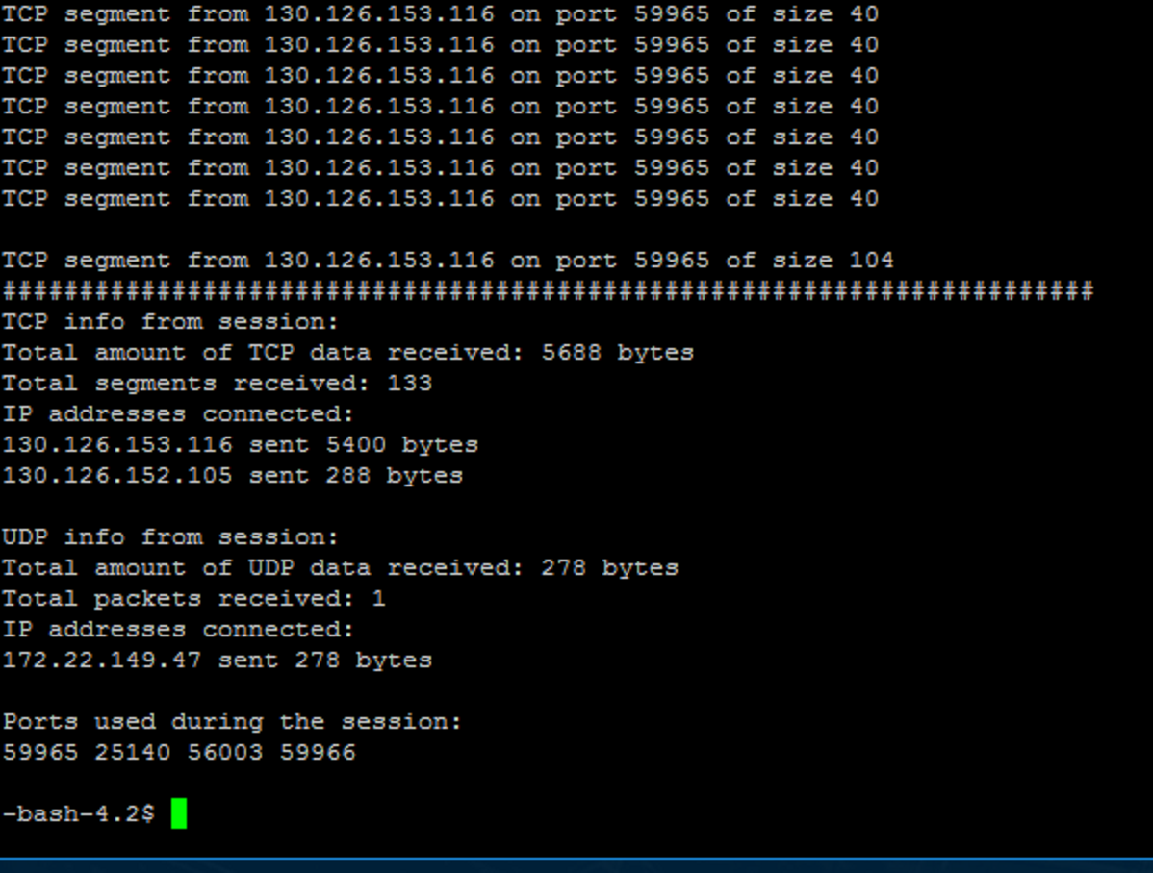
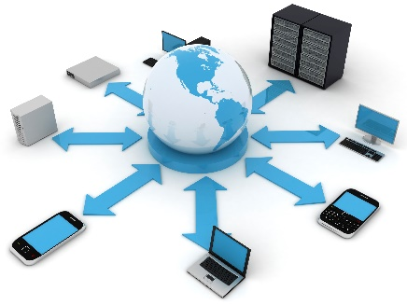
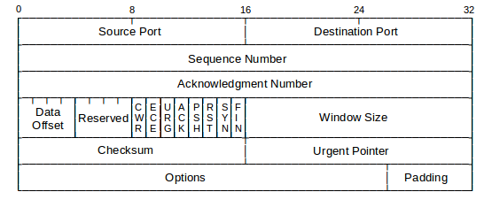
Network Window
John Pham
Purpose: To learn more about network coding and see how network data is received.
Summary: A “packet sniffer” that identifies incoming TCP and UDP data. Gives useful information such as size of data packet, source IPv4 address, and ports.
Technology Used: Just plain C code with networking header libraries.
Program Specifics: Forks two child processes to handle TCP and UDP packets. Creates a raw socket to listen on every port on the system.
Future Goals: Be able to monitor outgoing data, response times, and packet loss.

